Slide 1

20
WE
WELCOME TO THE
NJDA USDA FOODS CONFERENCE 2020RENCE
2020WELCOME TO THE
NJDA UDSA FOODS CONFERENCE
February 6, 2020
NJ CONVENTION AND EXPOSITION CENTER
EDISON, NEW JERSEY

Slide 2
IN THIS TRAINING WE WILL REVIEW
1. Food Distribution Team - Who We Are and What We Do
2. Your Entitlement/Planned Assistance Level
3. Your Options – Processed Commodities – USDA Foods – USDA DoD Fresh
4. Tools available to Use
5. Overview of each program
6. The Commodity Selection Worksheet – Changes and Submission Process
7. Drawdown & State Banks
8. Commodity Reporting – Value Pass Through, Commodity Acceptance Report
9. Filing Complaints
10. Division of Food and Nutrition Help Center

Slide 3
FOOD DISTRIBUTION Programs Organizational Chart
DENISE LIPTAK, MANAGER
FOOD DISTRIBUTION PROGRAMS
609-292-8344
JUSTIN PHIFER
ASSISTANT MANAGER
FOOD DISTRIBUTION
609-292-4683
KORY BURTNETT
AUDITING SUPERVISOR
FOOD DISTRIBUTION
609- 777-0537
PEGGY SALANO
SECRETARIAL
ASSISTANT III
609-984-2343
MARIA KEITT
TECHNICAL ASST. MIS
609-633-3613
JOAN NOVELLANO
PROGRAM COMPLIANCE SPECIALIST
609-292-3451
MARK DRAMIS
PROGRAM SPECIALIST
609-341-2733
BOB ORSON
NJDA INSPECTOR
609-571-5135
OPEN
NJDA INSPECTOR
609-571-5135

Slide 4
ENTITLEMENT AND HOW IT WORKS
FEDERAL – The Richard B. Russell National School Lunch Act mandates the use of a formula multiplying the previous year’s Average Daily Participation (ADP) by a per meal rate. The per meal rate is announced each July in the Federal Register. Current rate is $.3625
STATE - Each state receives a dollar value of products based on the overall total ADP of all of our Districts from the previous school year.
RECIPIENT AGENCY – Each RA participating in the NSLP is entitled to their planned assistance level (entitlement) based on the Entitlement Calculation.

Slide 5
HOW ENTITLEMENT IS DETERMINED
Planned Assistance Level
Entitlement = ADP x 180 School Days x $0.3625 (current meal rate)
Example: ADP: 1000 x 180 Days X $0.3625 Per
Meal Rate = $65,250.00 Entitlement
2020-2021 CSW Form reflects your Average ADP from
January 2019 - December 2019
Your school district entitlement is pre-populated at the top of the CSW form

Slide 6

THE GOAL – SPEND IT ALL!
Make decisions to maximize usage of entitlement dollars
Know your history and potential for new opportunities
Review your Commodity Value Acceptance Report
Decide between Processing, USDA Foods and USDA DoD Fresh
Track usage monthly in K12 and ProcessorLink
Check your invoices for your NOI – net off invoice
If you understand it, you can manage it!
Have fun with recipes – Contact Brokers and Processors
Use the tools on SNEARS
Call us for assistance with stagnant lbs. or low banks
Spend 100%

Slide 7

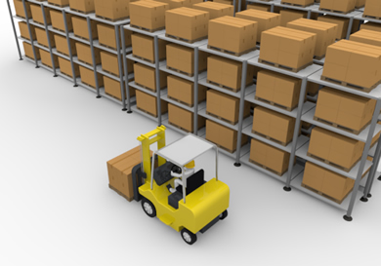

YOUR DIVERSION OPTIONS
PROCESSING
USDA FOODS
MONTHLY ALLOCATIONS
USDA DoD Fresh

Slide 8


PROCESSING
Processing is the conversion of raw commodity to a finished end product
Processing allows state distributing agencies and eligible recipient agencies such as school districts to contract with commercial food processors to convert raw bulk USDA commodities into more convenient, ready-to-use food products.
  Chicken Large Chilled Bulk – Chicken Nuggets
  Mozzarella Cheese – Pizza
  Potatoes, Bulk – French Fries

Slide 9

PROCESSING - USING THE DIVERSION CALCULATOR
Contains worksheets for every bulk commodity, by Processor, available for purchase in New Jersey
Each worksheet (tabs) show serving sizes, meal components, commodity credit per case and credit per serving for each commodity being offered
A tool to compare your actual usage with, to help redirect money potentially left on the table
On the individual worksheets you “play around” with your money and it totals for you on the summary page.
It is very easy to use! It is optional yet recommended.

Slide 10
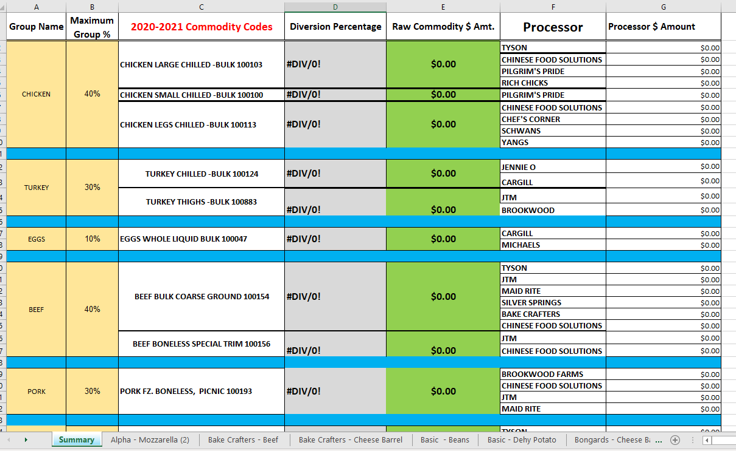
THE DIVERSION CALCULATOR

Slide 11
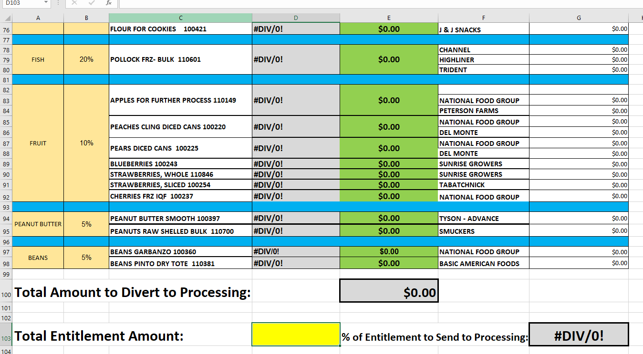
THE DIVERSION CALCULATOR

Slide 12
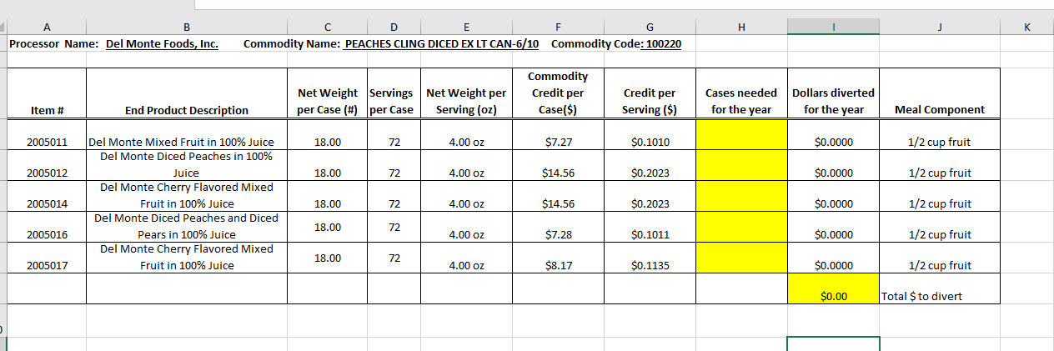
SAMPLE OF A WORKSHEET

Slide 13

USDA Foods
Monthly Allocations through the Warehouse

Slide 14

USDA FOODS - MONTHLY ALLOCATIONS
Warehouse diversions refers to diverting entitlement so that you receive monthly allocations of USDA Foods through one of the state contracted warehouses
How it Works:
RA determines the percentage of their entitlement that they want to divert to monthly allocations. This is done on the header of the CSW
RA then completes a Warehouse/DoD Allocation Worksheet and submits to the NJDA
NJDA orders products from the USDA based on the summary of the Warehouse/DoD Worksheets
RA receives Monthly Allocation Form with items to choose from
RA completes Allocation Form on SNEARS by the 10th of the month
Picking Ticket is Generated on SNEARS
Receive Monthly Delivery Based on Pre-Scheduled Pick-Up Date

Slide 15

Changes to Warehouse Items for 2020-2021
Change in Pack Size
  MIXED VEGETABLES, NO SALT, FRZ 6/5 lb. packages from a 30 lb. case
Kosher Products
  CORN WHOLE KERNEL(LIQ) CAN-6/#10
  APPLESAUCE UNSWEETENED CAN-6/10
  YOGURT, HIGH PROTEIN, VANILLA 6/32 OZ TUBS
  YOGURT, HIGH PROTEIN, BLUEBERRY 24/4 OZ
  YOGURT, HIGH PROTEIN, STRAWBERRY 24/4 OZ
  YOGURT, HIGH PROTEIN, VANILLA 24/4 OZ
New Product
  CHEESE PEPPER JACK SHRED BAG-4/5#

Slide 16
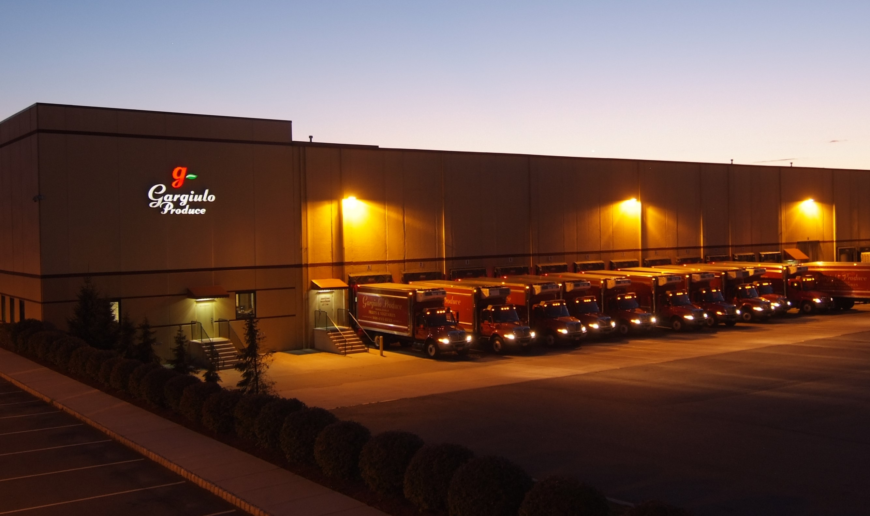
USDA DoD Fresh Fruit and Vegetable Program
(USDA DoD Fresh)
The United States Department of Agriculture (USDA) Department of Defense (DoD) Fresh Fruit and Vegetable Program allows schools to use USDA Foods entitlement dollars to buy fresh produce. The program is operated by the Defense Logistics Agency (DLA) at the Department of Defense (DoD).
Program Growth
The Current USDA DoD Fresh Vendor is Gargiulo Produce
School Year | Year | Number of Participants | Amount of Funding
2014/2015 | Pilot | 15 | $629,972.00
2015/2016 | Year 1 | 154 | $3,839,477.00
2019/2020 | Year 5 | 360 | $9,745,869.00

Slide 17

USDA DoD Fresh
How It Works
School Districts determine the amount of Entitlement to set aside for DoD produce when completing the DoD-Warehouse Allocation Worksheet
School Districts have an account in the web based FFAVORS system to select and order produce on a weekly basis
  $150 minimum order per delivery
Produce is delivered weekly directly to the School District
No out of pocket expenses; funds are drawn down from DOD Entitlement

Slide 18
USDA DoD Fresh
Advantages of the Program
Points to Consider
Over 70 different types of produce
Vendor Catalog updated weekly
Opportunity to purchase locally grown product
School District selects the products and amounts they want to order weekly
Direct delivery of produce on a weekly basis
User friendly ordering system
Excellent way to use entitlement dollars if entitlement dollars were leftover last school year
DoD entitlement dollars are part of your Warehouse Allocation Percentage selected on the CSW Worksheet
Your effective ADP will be adjusted on your monthly warehouse allocation
Will need to receipt for product received
Will not receive fresh produce as part of the monthly warehouse allocation

Slide 19
GO TIME!

Slide 20
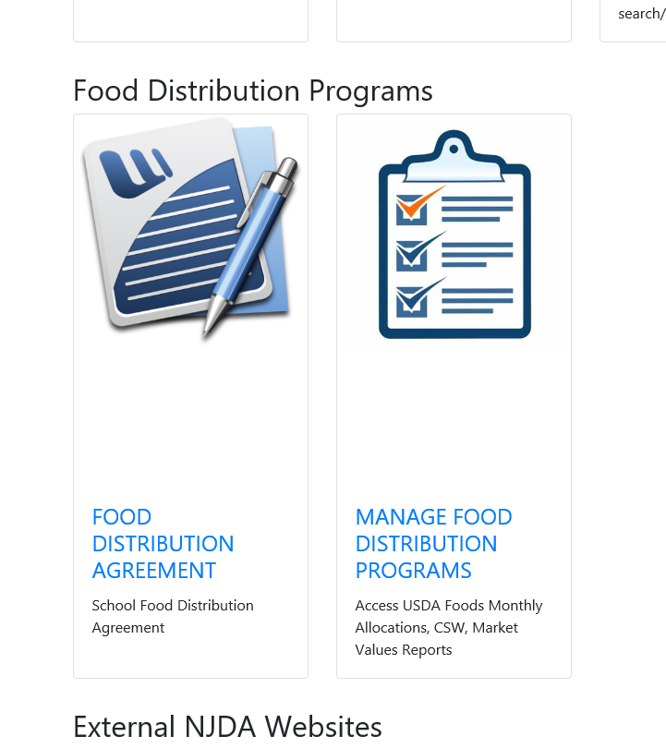
COMMODITY SELECTION WORKSHEET

Slide 21
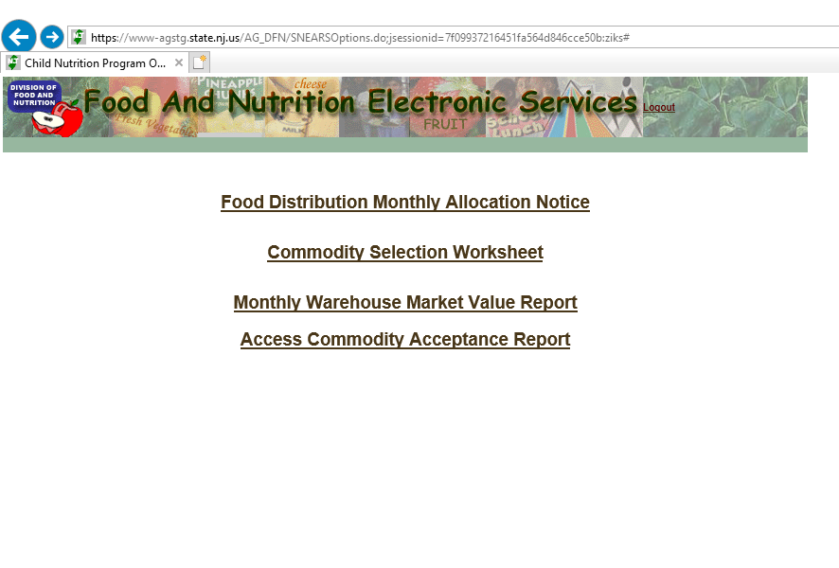

COMMODITY SELECTION WORKSHEET

Slide 22
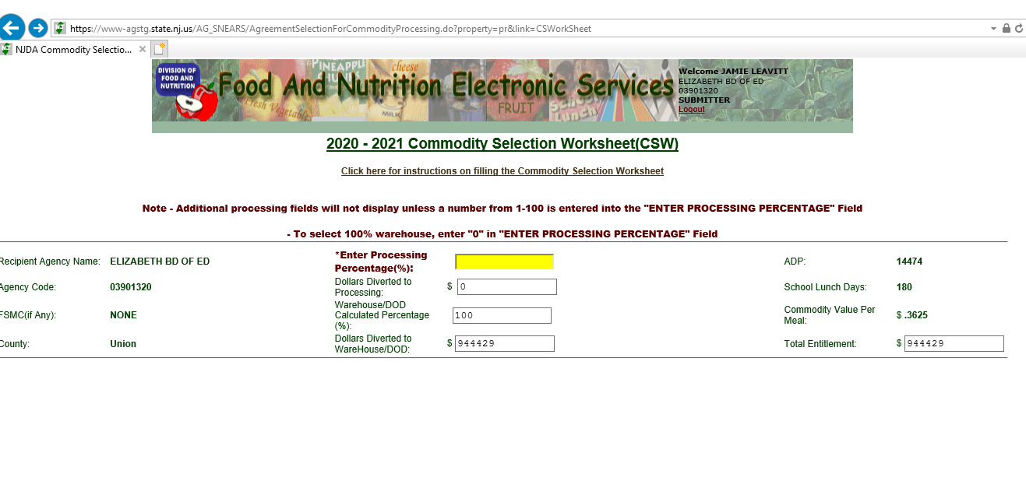





Slide 23
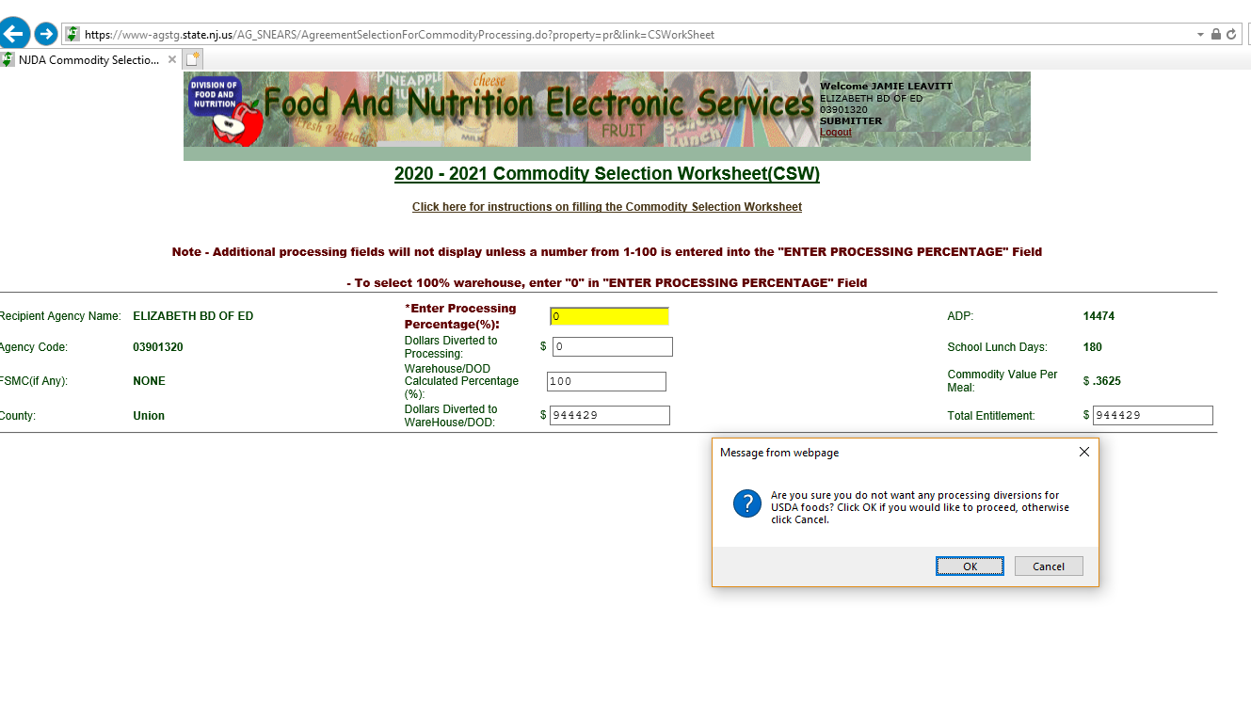




Slide 24
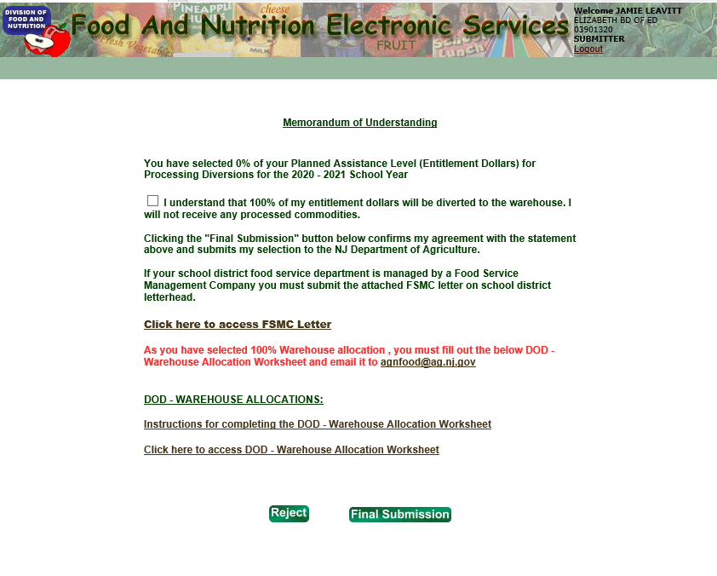

Slide 25
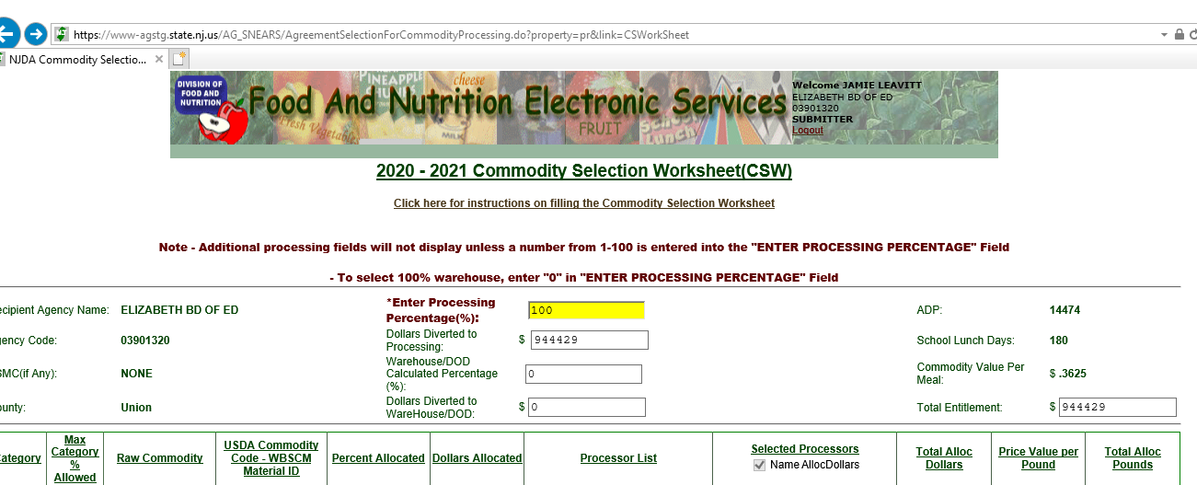





Slide 26
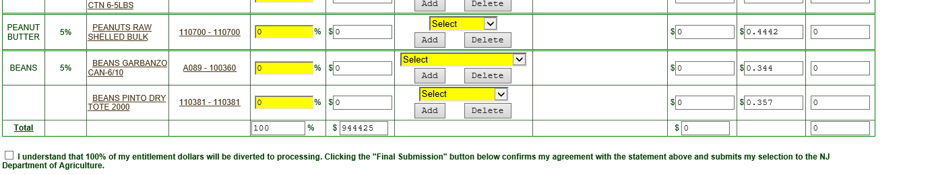

Slide 27
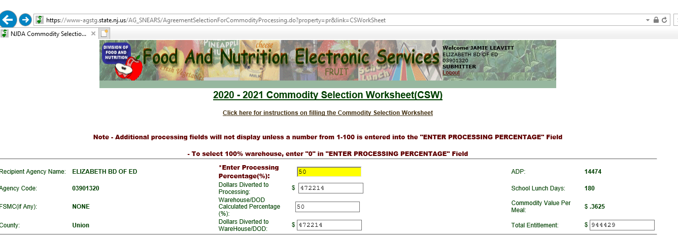




Slide 28
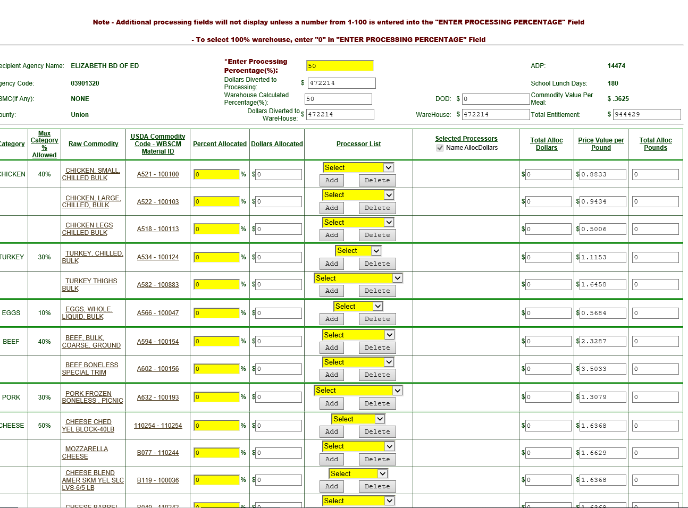




Slide 29
SAMPLE OF A WORKSHEET

Slide 30
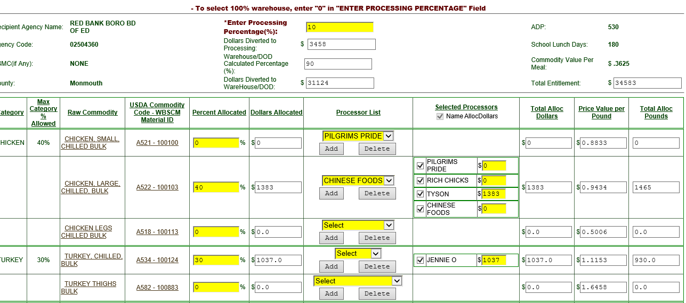




Slide 31
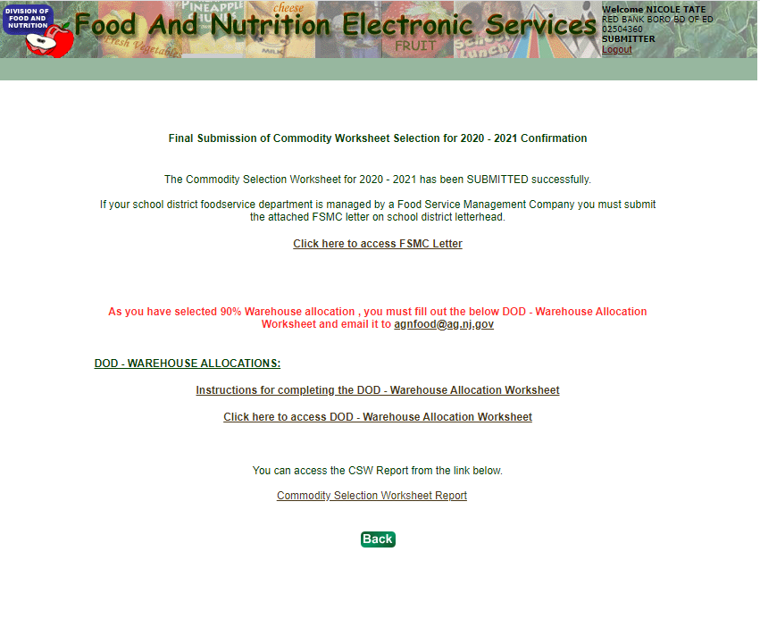

Slide 32

DoD/Warehouse Allocation Worksheet

Slide 33
DoD-Warehouse Allocation Worksheet
Determines the Types and the Amounts of Products Offered from the Warehouse
Mandatory to Complete (Unless you divert 100% towards Processing)
The Spreadsheet must be completed and emailed to agnfood@ag.nj.gov by the CSW form due date
Warehouse Diversions-Will not get exactly what you requested
*NEW-The spreadsheet is now universal and should be used for DoD, Warehouse, and those diverting to both programs
*IMPORTANT-DOLLARS DIVERTED TO WAREHOUSE MUST MATCH THE AMOUNT ON THE COMMODITY SELECTION WORKSHEET IN SNEARS

Slide 34
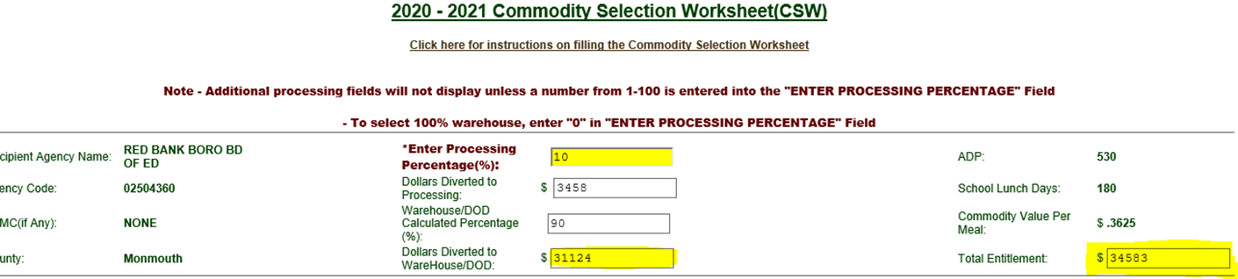

Helpful Hints
Record the amount diverted to Warehouse/DoD when completing the CSW
Record total amount of entitlement if not diverting towards processing at all

Slide 35
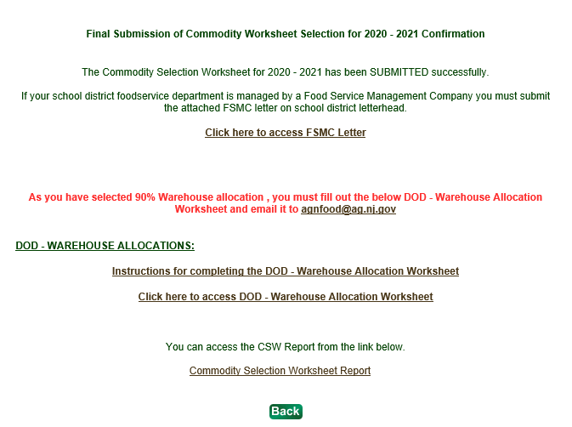
How to Access DoD-Warehouse Spreadsheet
DO NOT SEND PREVIOUS YEARS WORKSHEETS!!!!!

Slide 36
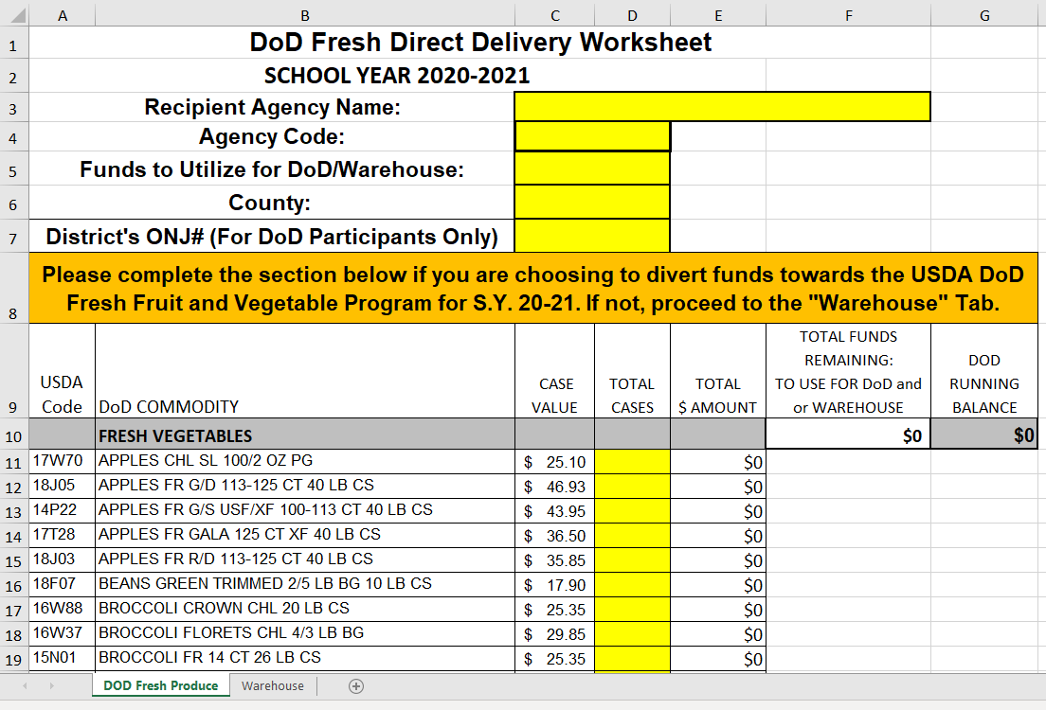

Slide 38
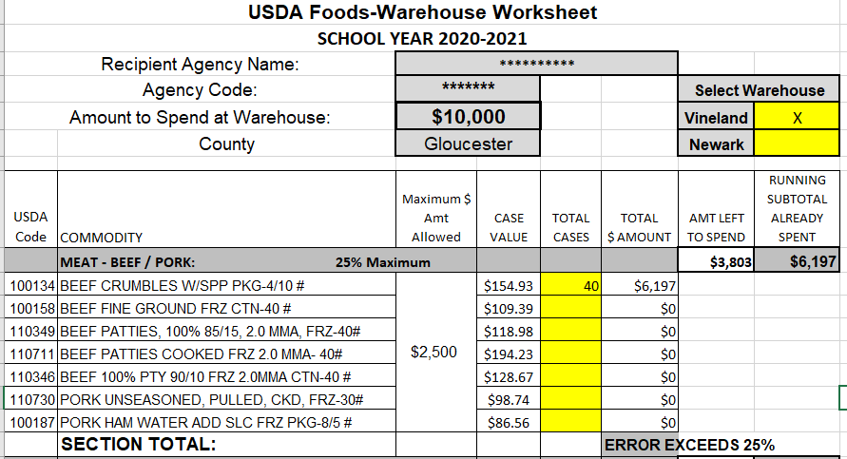

Slide 39
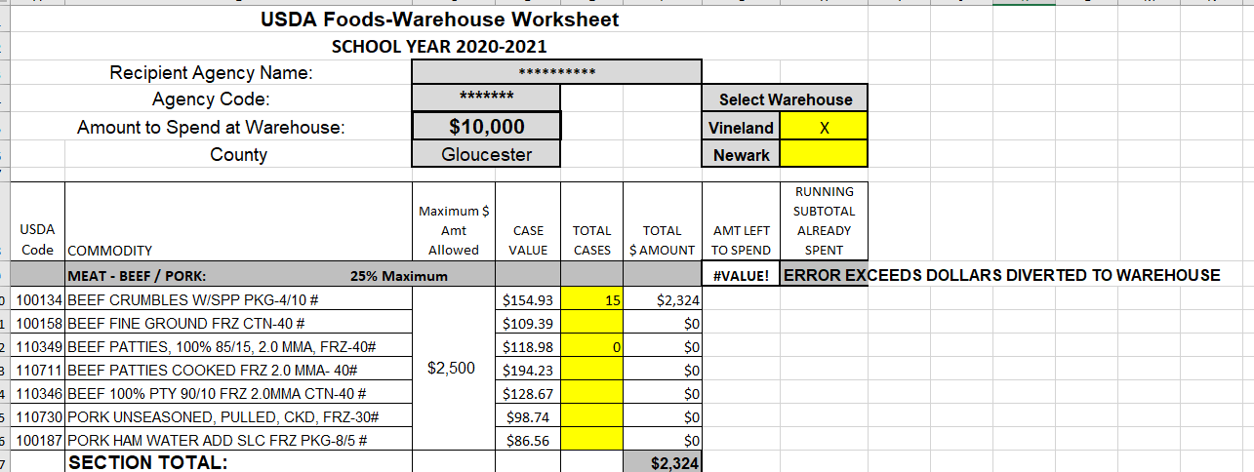

Slide 40

Instructions for Submittal
Email completed spreadsheet to- agnfood@ag.nj.gov
Submit by your CSW Worksheet Deadline
Worksheet must be submitted without errors
Only 1 worksheet can be submitted per email
Subject of email should read: County, District Name, RA#
  Example: Mercer, Trenton BOE, 00112233
If you have any questions or need assistance with completion of the form, please contact Peggy Salano, peggy.salano@ag.nj.gov (609) 984-2343.

Slide 42

Additional Program Information

Slide 43
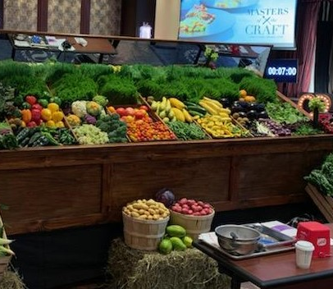
USDA DoD Fresh

Slide 44

Recipient Agency (RA)
Responsibilities
Inspect produce at time of delivery
  Verify the correct amount and type of produce ordered is what is delivered
  Reject produce that does not meet U.S. No 1 or is non-domestic
  Take photos of any issues
  Document issues on delivery document and in FFAVORS
Hidden Damage
  Report issues with produce quality, condition, or delivery within (1) business day to: Produce Vendor, DLA Representative, NJDA
  Include Photos
Receipt in FFAVORS within 5 days
Notify vendor of school holidays/closures
Monitor account balance in FFAVORS
Utilize funding within school year

Slide 45
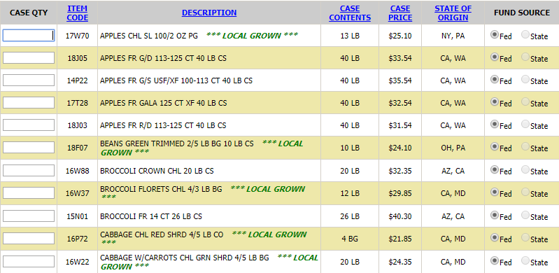

Keeping it Local
Vendors are encouraged, when seasonally available, to source local products
DLA defines local as within that state and bordering states
Vendor is required to list State of Origin in the FFAVORS catalog

Slide 46

Additional Funding
Sometimes made available by:
  Sweeps
  Cancelled Orders
Never a Guarantee
Must submit a DoD Additional Funding Request Form (NJDA)

Slide 47
Who should I contact?
USDA DoD Fresh
Program Activity | Responsible Entity
Issues with Funding | NJDA
Add or Update FFAVORS User & POC | NJDA
FFAVORS Login Issues | DLA
Request to add new produce items | Vendor, DLA Representative, NJDA
Complaints ☹ Product Quality, Availability, Delivery Issues | Vendor, DLA Representative, NJDA
Recurring Complaints | NJDA
Additional Delivery Site Requests | NJDA
    NJDA:
    Peggy Salano 609-984-2343 peggy.salano@ag.nj.gov Justin Phifer justin.phifer@ag.nj.gov
  DoD Contracted Vendor:
    Gargiulo Produce 908-233-8222
    DODcustomersupport@gargiuloproduce.com
  DLA Representative:
    Vera Strilchuk 410-977-0003
    vera.strilchuk@dla.mil

Slide 48

USDA Food Complaints

Slide 49

Why Report Complaints?
To provide feedback on the quality of USDA Foods products received
To document concerns based on packaging conditions
To document concerns based on foreign materials found in a product

Slide 50

Reporting a Complaint
Shoot
Photos of the product as well as the case packaging and product label
Never
Dispose of product and packaging until instructed to dispose of by the NJDA Food Distribution Staff
Complete the “USDA Foods Product Complaint Form”
Provide
The NJDA the following:
Complaint Form
Corresponding Picking Ticket
Photos
Always

Slide 51


TOOLS AVAILABLE TO ASSIST YOU
SNEARS Resources
Processor Link
K12 Food Services
Commodity Value Acceptance Report
Food Distribution Team
CSW Webinar

Slide 52
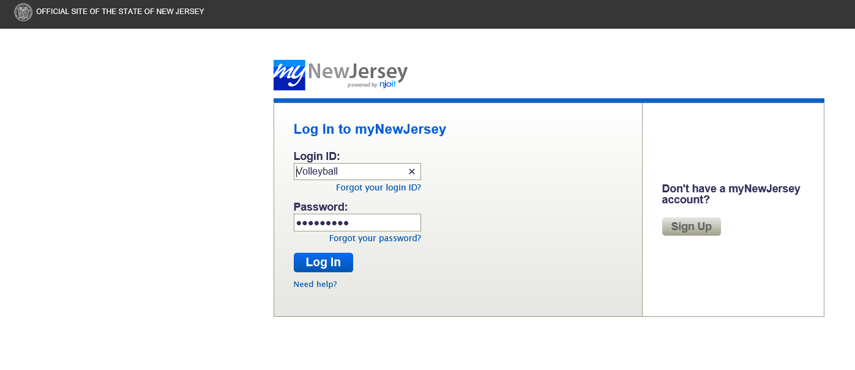
SNEARS ACCESS

Slide 53
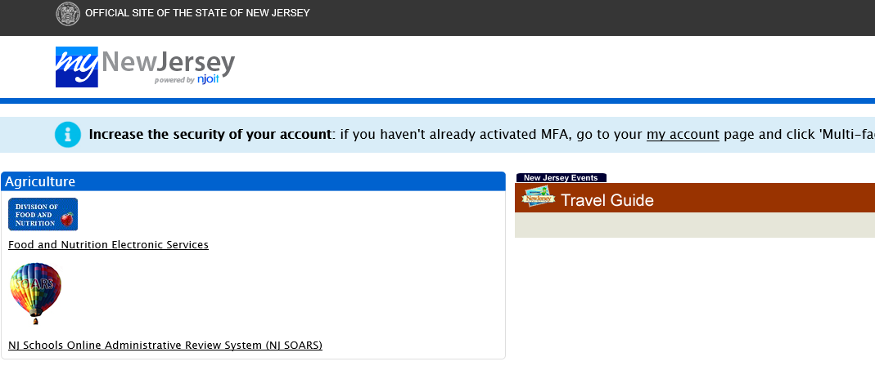


SNEARS ACCESS

Slide 54
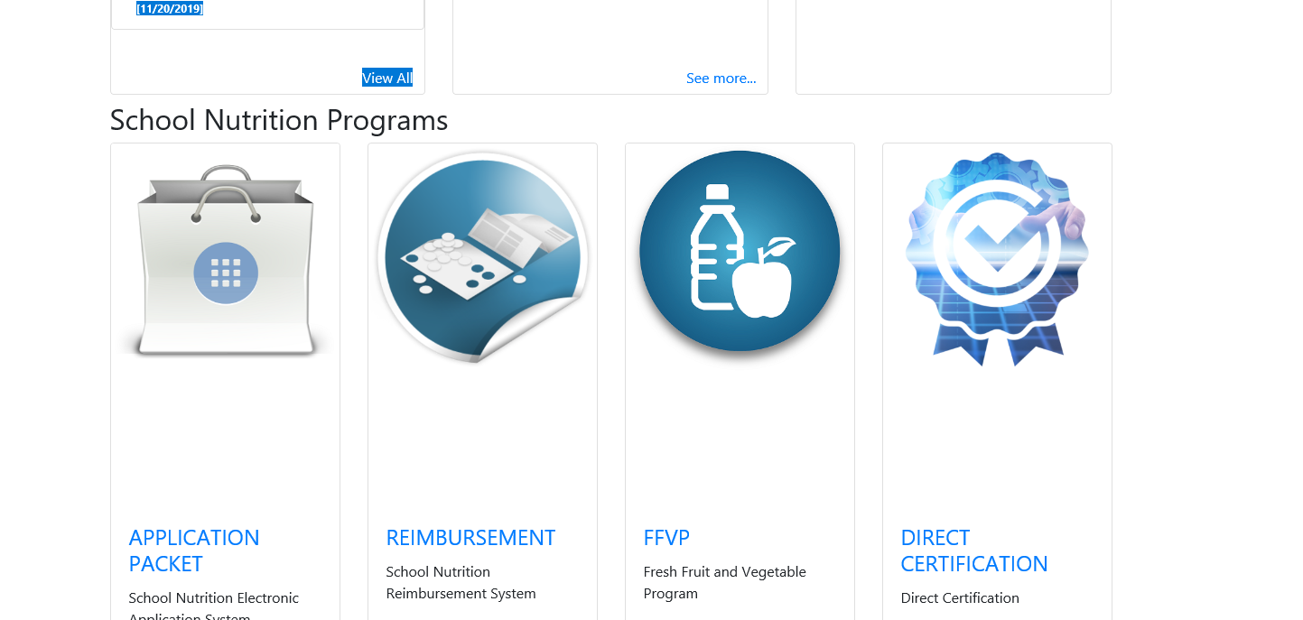







SNEARS ACCESS

Slide 55
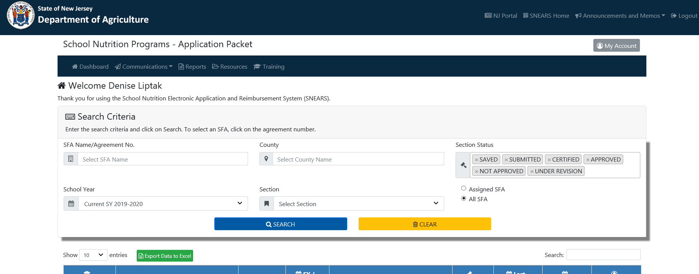




SNEARS ACCESS

Slide 56
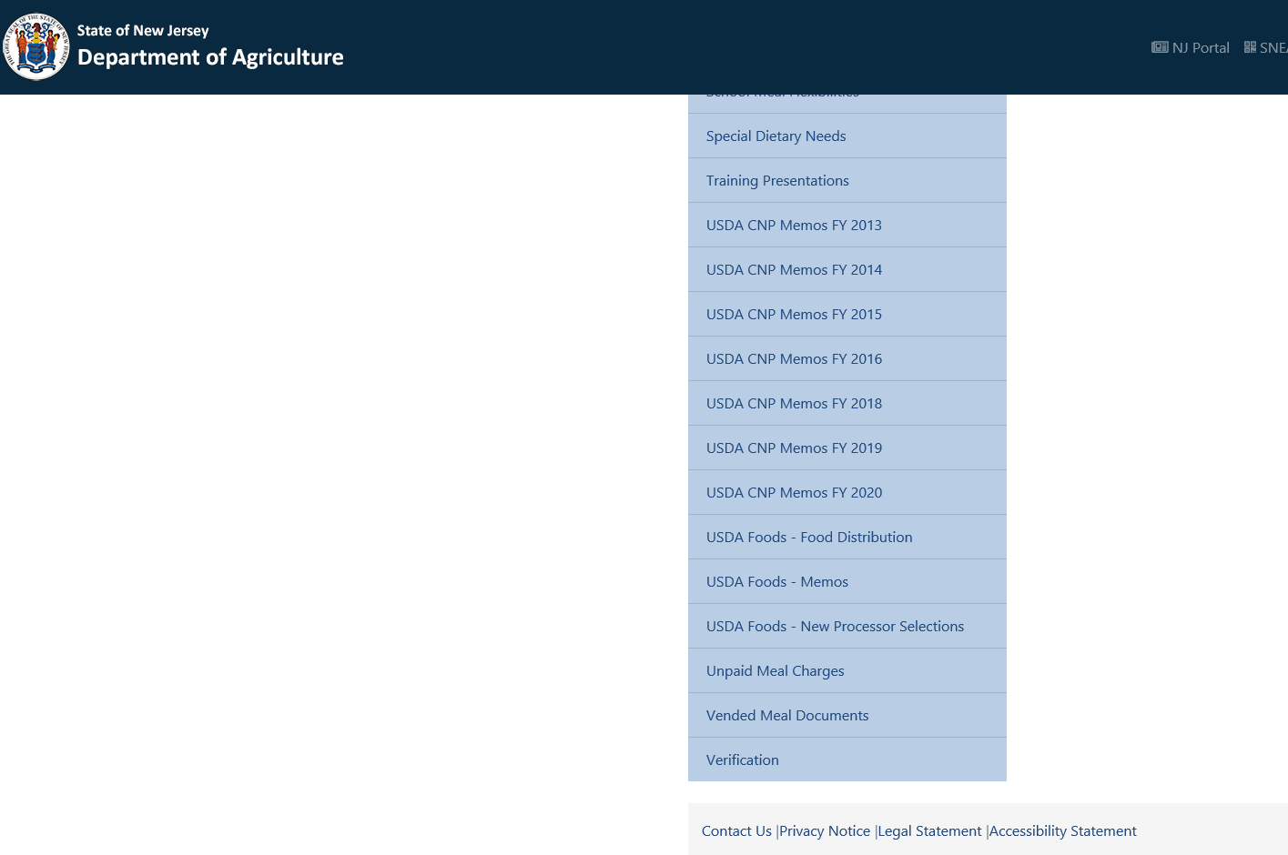




SNEARS ACCESS

Slide 57
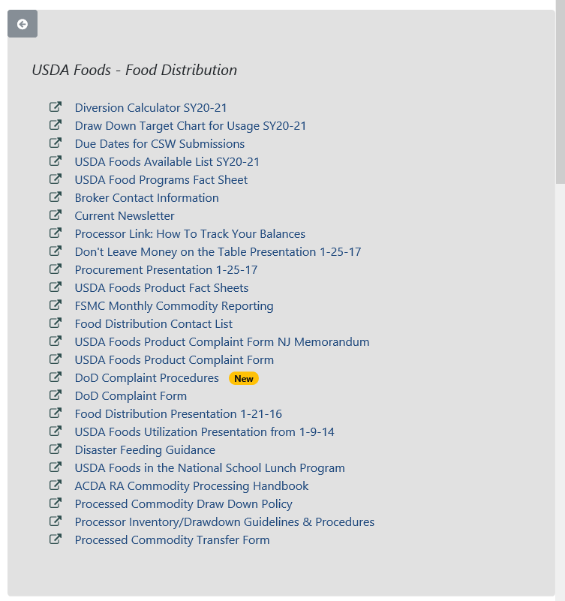
SNEARS ACCESS

Slide 58
DUE DATES FOR CSW SUBMISSIONS
Counties Due: February 28th, 2020
Atlantic, Burlington, Cape May, Cumberland, Gloucester, Salem and Ocean
Counties Due: MARCH 6TH, 2020
Camden, Hunterdon, Mercer, Middlesex, Monmouth, Somerset and Union
Counties Due: MARCH 13TH, 2020
Bergen, Essex, Hudson, Morris, Passaic, Sussex and Warren
Along with the submission of the CSW you must send in your warehouse and/or DoD worksheets. The complete package must be submitted together.
FSMC letters need to be received by NJDA by MARCH 13TH, 2020

Slide 59


Drawdown - Sweeps

Slide 60
DRAW DOWN TARGET CHART FOR USAGE
YTD USAGE REMAINING BALANCE
SEPTEMBER 28 | 10% | 90%
OCTOBER 31 | 25% | 75%
NOVEMBER 30 | 35% | 65%
DECEMBER 31 | 45% | 55%
JANUARY 31 | 55% | 45% | Mandatory Draw-Down
FEBRUARY 28 | 65% | 35%
MARCH 29 | 75% | 25%
APRIL 30 | 85% | 15%
MAY 31 | 95% | 5% | Possible Draw-Down
JUNE 30 | 100% | 0% | Mandatory sweep of all pounds
Note: You should not see pounds transferred from your banks prior to the mandatory sweep in January.

Slide 61

HANDS ON TRAINING AT NJDA
Two scheduled trainings for the selections process
Sign-up at the NJDA Help Desk
February 21, 2020 – 9:30 a.m.
March 5, 2020 – 9:30 a.m.
This presentation will be posted on SNEARS under resources

Slide 62
PROFESSIONAL STANDARDS TRAINING HOURS
FOR THIS SESSION
Key Area – Food Distribution
Training Topic –
USDA Foods and Operations 2000
1 hour

Slide 63
Thank you for joining our session and enjoy the rest of the conference

